Slide 1

Board Game Recommendation System
Recommend the most suitable board game for you !

Slide 2
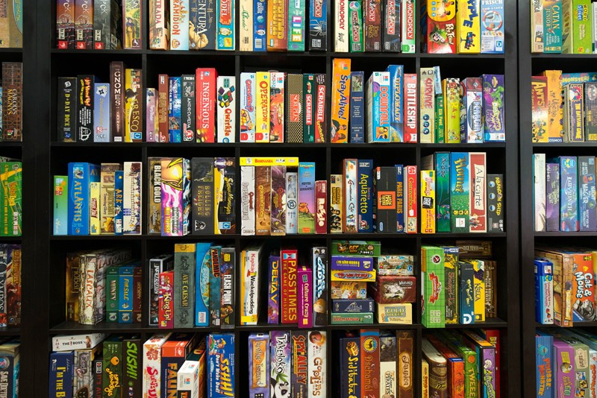
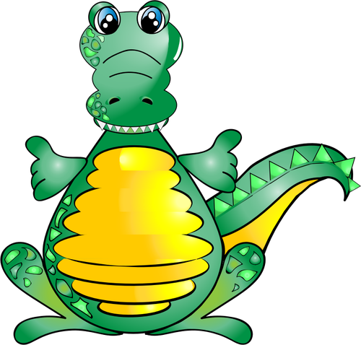
The Business Problem
In our digital store we have nearly 22K board games.
The problem is which board game do we recommend to which user ?

Slide 3
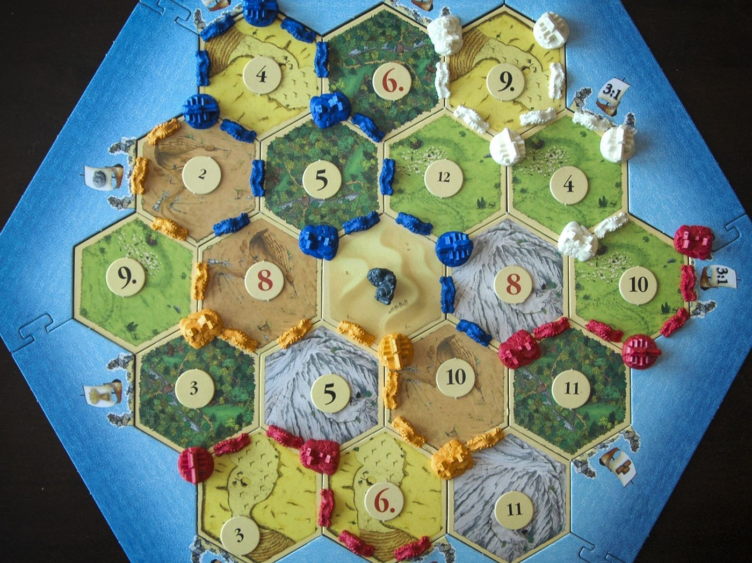
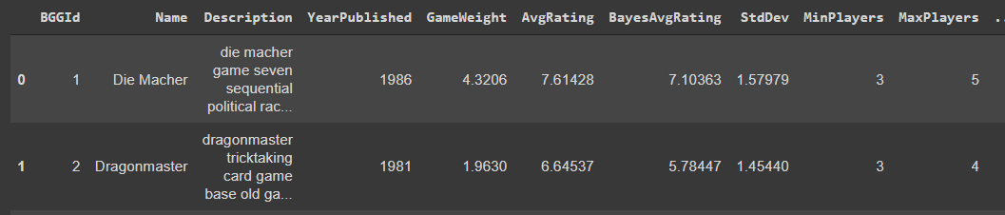
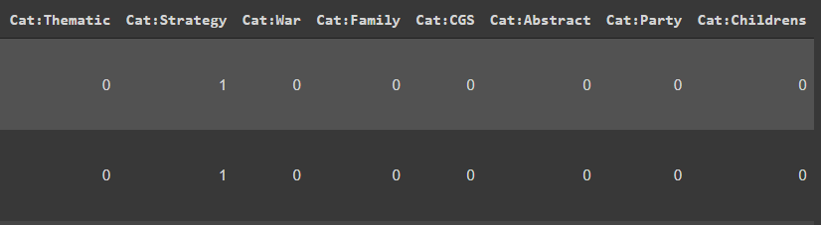
The Data
The data include the following CSV’s :
Games - ~22K games. see top below.
Mechanics - binary Features of game mechanics (Dice Rolling ,Physical , etc.)
Subcategory - binary Features of game subcategories (Puzzle ,Card Game ,Electronic)
Themes - binary Features of game themes (Pirates , Zombies ,Vikings).
User ratings - ~411K users and ~18M votes of users on different board games.
Data not used : artists & publishers - binary features.
Overall we used 391 binary game features to ‘define’ a game.
Games head:

Slide 4
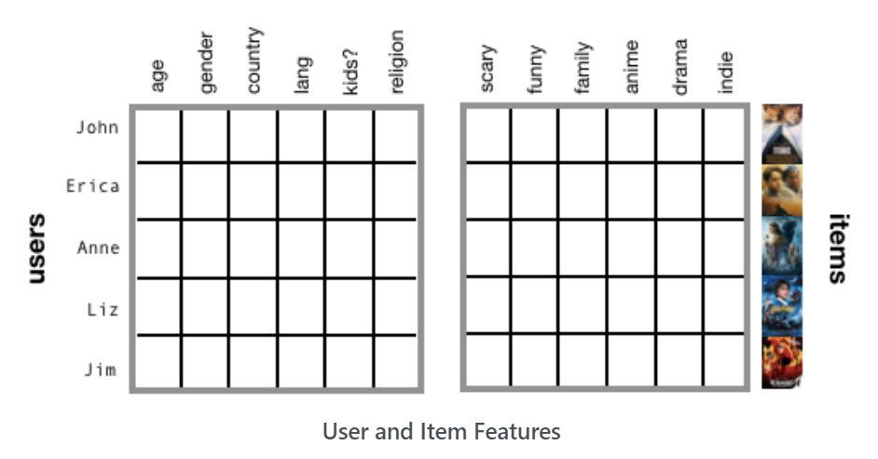
Content-based filtering
User features (age, gender, etc.) and\or item features (game genre, release date, mechanics ).
Handled cold-start problem.
👍 Advantages:
No need in other users data.
Can recommend niche items that are not popular.
👎Disadvantages
Limited ability to expand on the users' existing interests.
The model can only be as good as the hand-engineered features .
Notes:
Content-based filtering handles the cold-start problem because it doesn’t need any interaction data to generate recommendations. Instead, it looks at user features (e.g., age, gender, spoken language, employment, etc.) and item features (e.g., movie genre, release date, cast).

Slide 5
Content Based Filtering Pipeline
Use cosine nearest neighbors
Take 3 top rated games of the user.
Create a vector representing the avg of those 3 games
Take the top 10 nearest neighbors.
Calculate final score = similarity * avg game score.
Take only the features that are included in user’s top rated games (out of ~400 features).
Use cosine nearest neighbors
Top Rated Games of user i
Present top 10 games

Slide 6
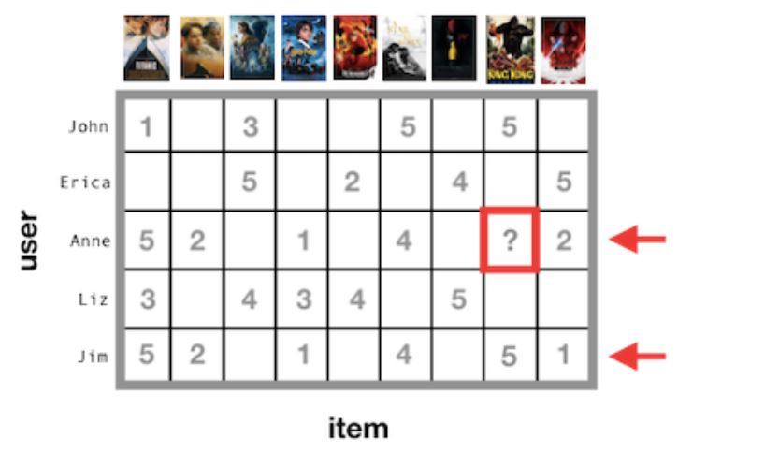
Collaborative filtering
Similar people like similar things.
Predict a user’s preferences based on the feedback of similar users.
Explicit vs implicit feedback, or a hybrid of both.
User-item matrix (AKA “utility” matrix).
The user-item matrix is very sparse.
*** Matrix factorization
👍 Advantages:
Diversity - The model can help users discover new interests.
No domain knowledge necessary - there is no need define the attributes of an item.
👎Disadvantages
Cannot handle new users & new games - cold-start problem
Notes:
Collaborative filtering is based on the concept of “homophily” - similar people like similar things. The goal is to predict a user’s preferences based on the feedback of similar users.
Collaborative filtering uses a user-item matrix (also known as a “utility” matrix) to generate recommendations. This matrix is populated with values that indicate a user’s degree of preference towards a given item. These values can represent explicit feedback, implicit feedback, or a hybrid of both. It’s very unlikely that a user has interacted with every item, so in most cases, the user-item matrix is very sparse.

Slide 7
Collaborative filtering Model Pipeline
List of top 5 choices for customer!!
Use cosine nearest neighbors to find users that rated the games the same as the customer
User rating data set that rated more than 15 games
Get only the top 10% of similar users
Filter the rating data set for only 10% of similar users and removing all customer games
Filter to other users that rate at least 50% of games that costumer rate
Filter games that customer rated
Calc games that customer didn’t play by combine score of on the similar users rating and game popularity.
Notes:
change title to “collaborative filtering
pipline” …. ?

Slide 8
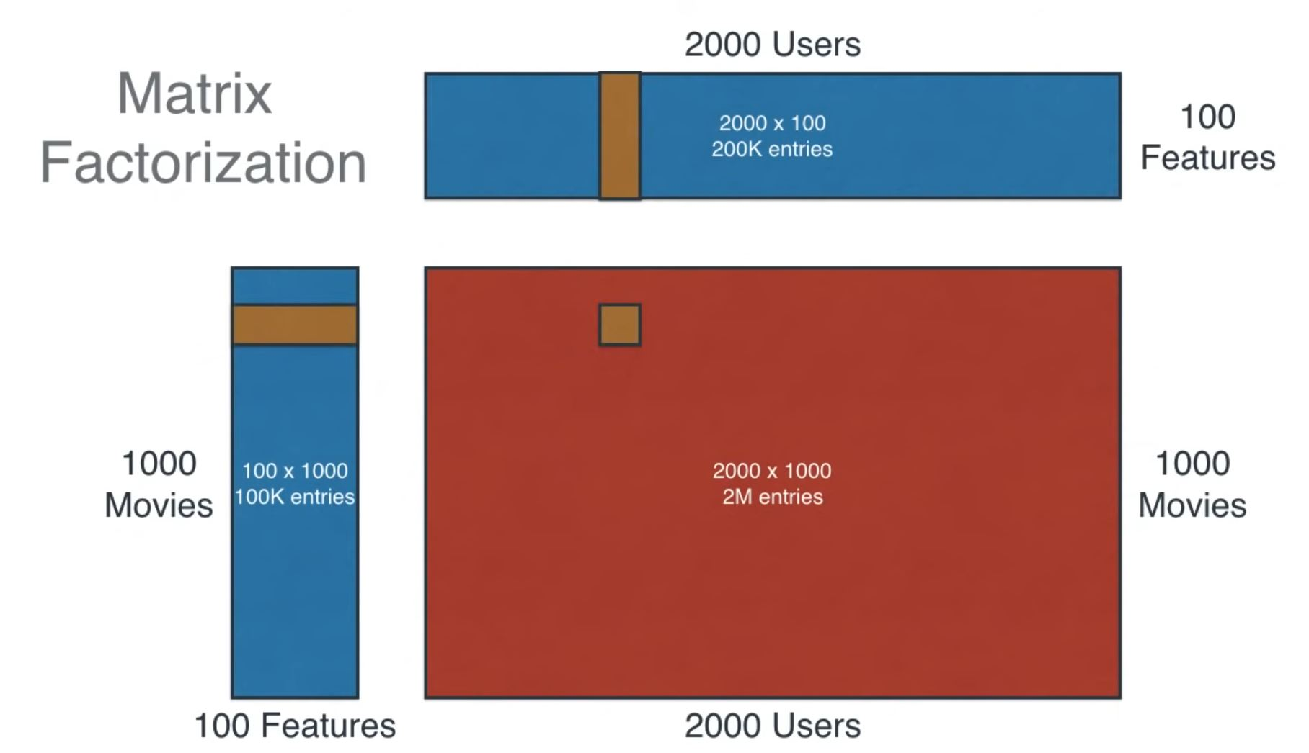
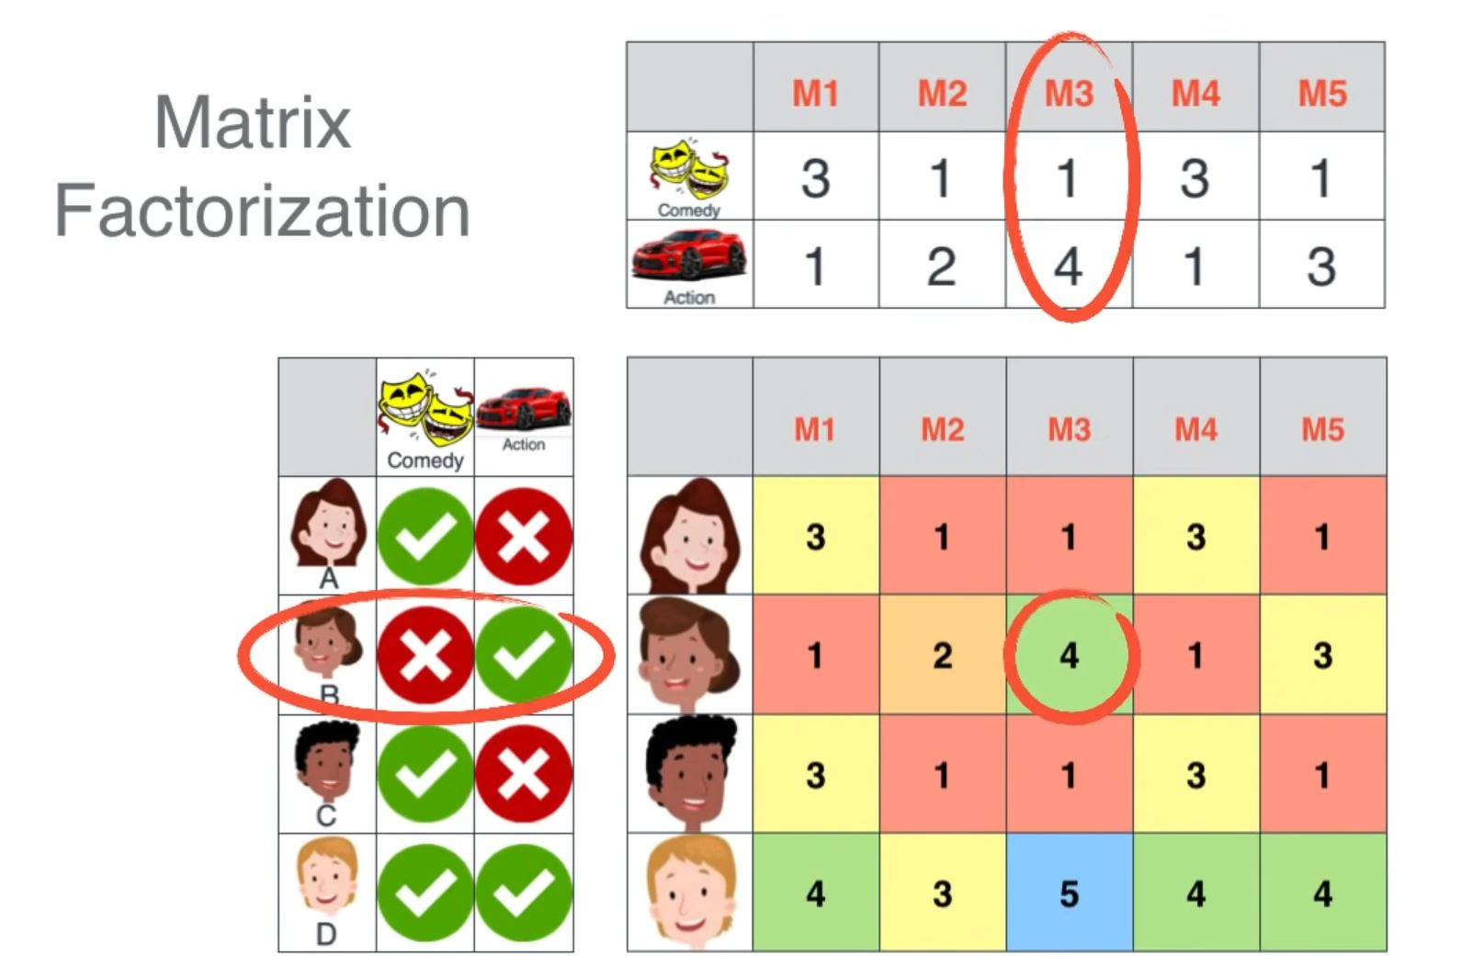
Matrix factorization(explain in details )

Slide 9
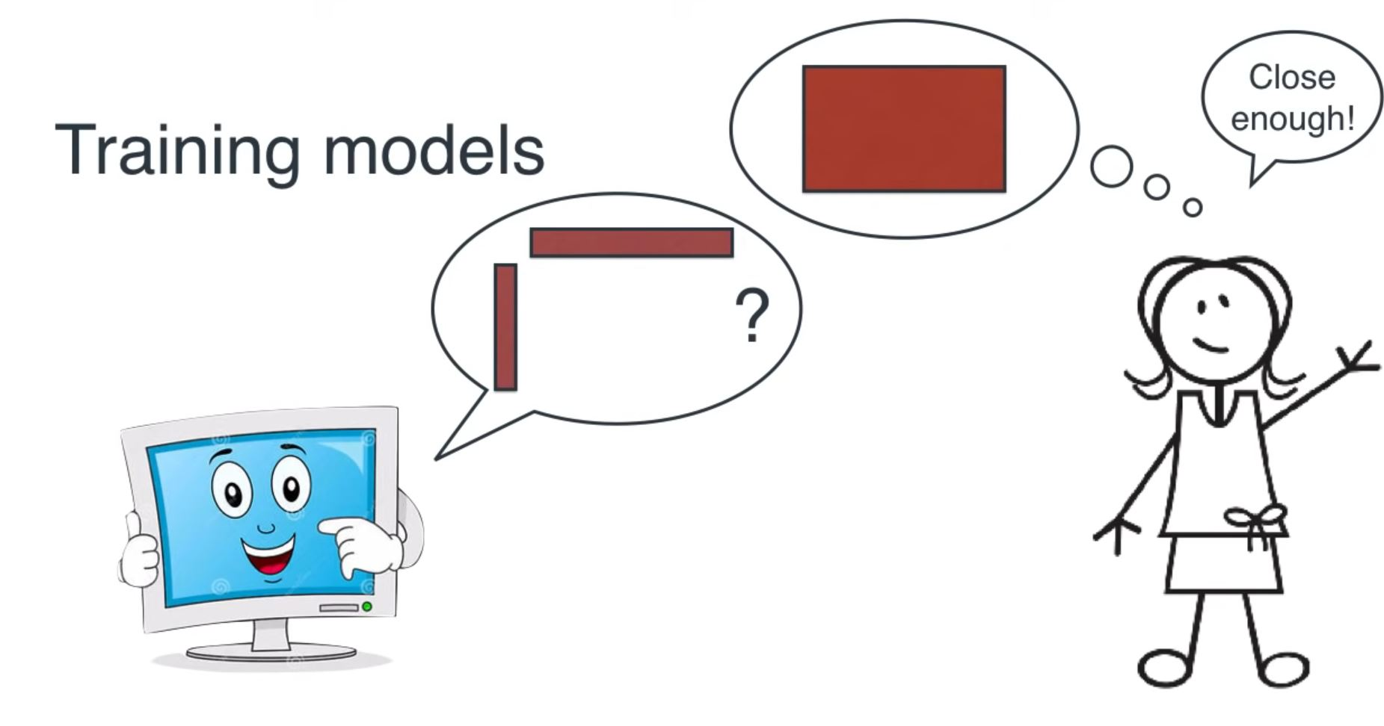
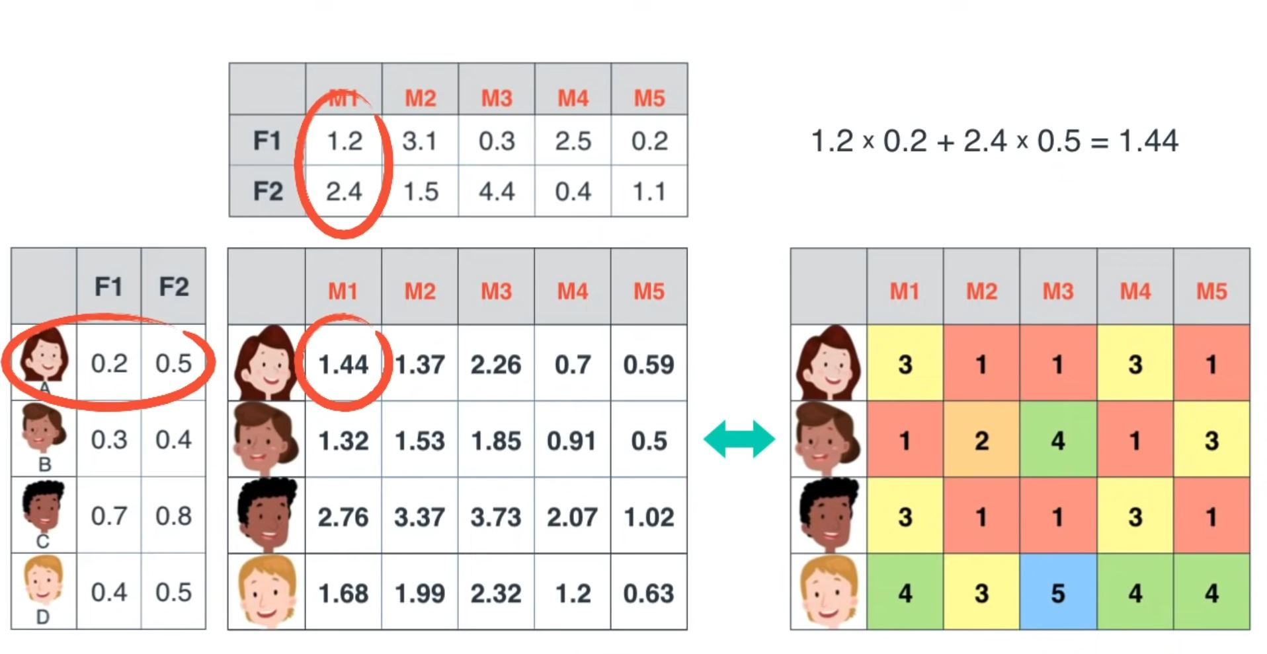
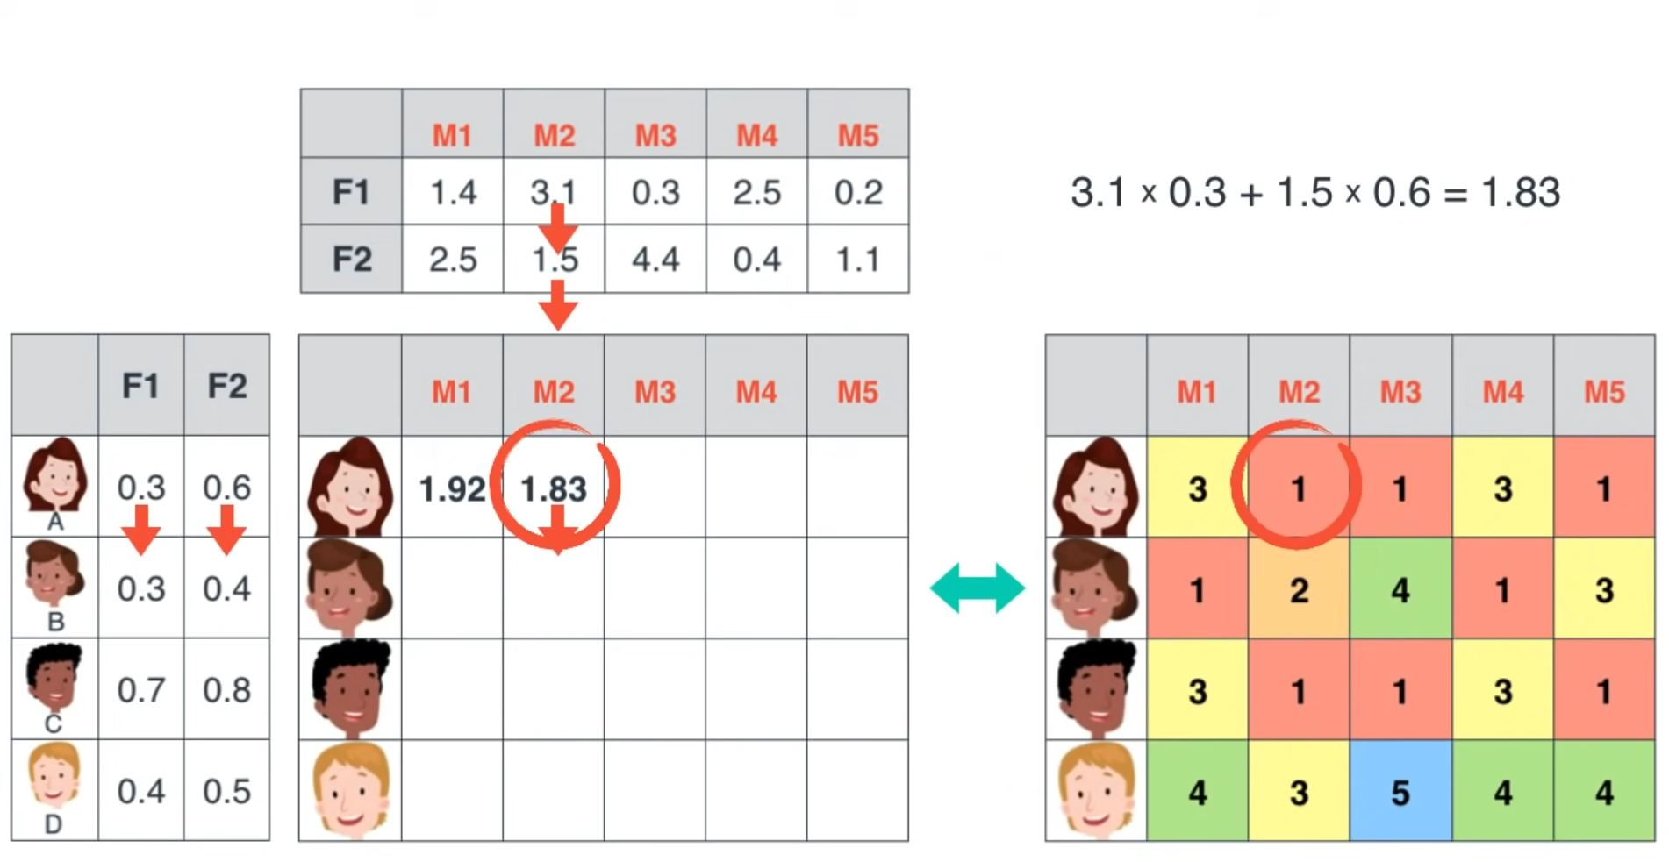
Matrix factorization(explain in details )

Slide 10
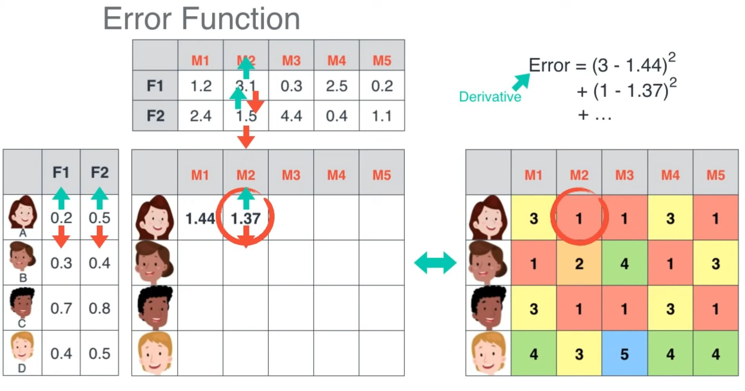
Matrix factorization(Error function )
Notes:
-using gradient descent to find best min error

Slide 11
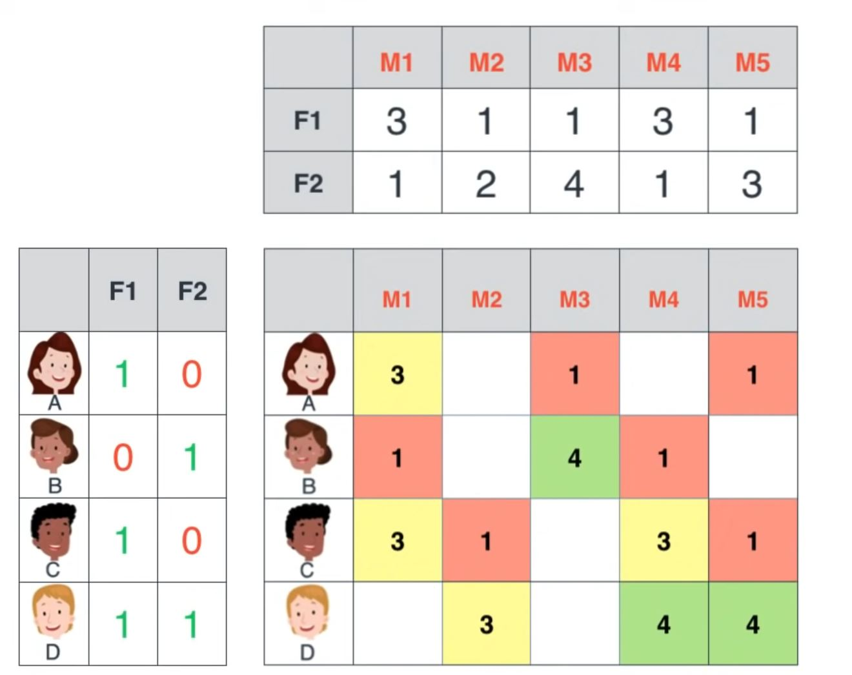
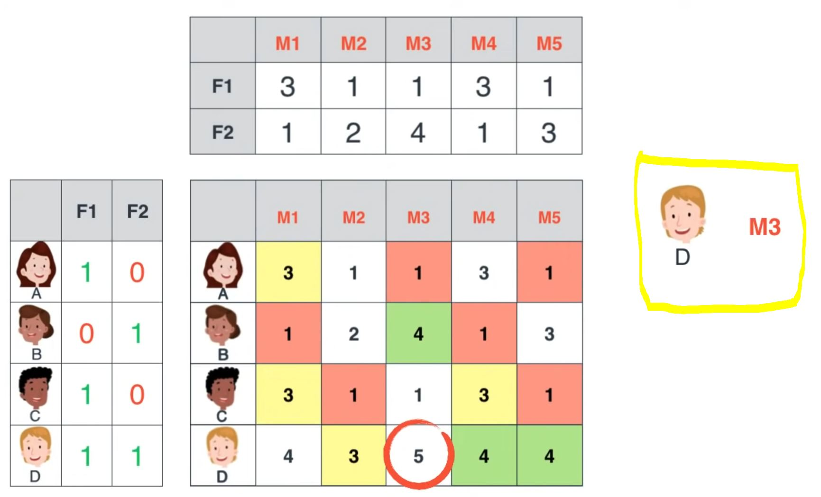
Matrix factorization (netflix )
Notes:
in real life the matrix is more scarce so we use the factor we train to prod the movies the user want to see

Slide 12
Content- based filtering
Collaborative filtering
👍 Advantages:
No need in other users data.
Can recommend niche items that are not popular.
👎Disadvantages
Limited ability to expand on the users' existing interests.
The model can only be as good as the hand-engineered features .
👍 Advantages:
Diversity - The model can help users discover new interests.
No domain knowledge necessary - there is no need define the attributes of an item.
👎Disadvantages
Cannot handle new users & new games - cold-start problem

Slide 13
Evaluate a recommender system
In classification problem
In recommender system
Train
Test
Train
Test

Slide 14


Surprise Package for Recommendation System
Deal with explicit rating data.
Train - test method
Evaluate based on RMSE.
Supports collaborative filtering ; not supporting Content-based filtering.
Notes:
Surprise is a Python scikit for building and analyzing recommender systems that deal with explicit rating data.
Built in models with train - test method designed for recommendation system.
Evaluate the recommendation system based on MSE from prediction.
Supports collaborative filtering and basic algorithms.
Content-based filtering is not supported.

Slide 15
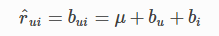
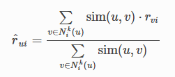
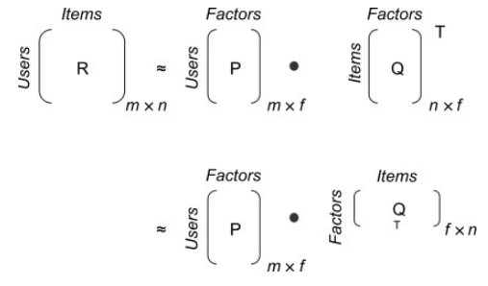
Types of Models
Basic Algorithm
random_pred.NormalPredictor - Algorithm predicting a random rating based on the distribution of the training set, which is assumed to be normal.
baseline_only.BaselineOnly - Algorithm predicting the baseline estimate for given user and item.
KNN’s
KNNBasic - A basic collaborative filtering algorithm.
KNNWithMeans - A basic collaborative filtering algorithm, taking into account the mean ratings of each user.
KNNBaseline - A basic collaborative filtering algorithm taking into account a baseline rating.
Matrix Factorization-based algorithms
SVD - The famous SVD algorithm, as popularized by Simon Funk during the Netflix Prize. When baselines are not used, this is equivalent to Probabilistic Matrix Factorization (similar to PCA ).
Matrix_factorization.NMF - A collaborative filtering algorithm based on Non-negative Matrix Factorization.
For more Info :https://surprise.readthedocs.io/en/stable/prediction_algorithms_package.html
Notes:
random - פרדיקציות רנדומליות מבוססות על פי התפלגות של המידע באימון כשהוא מניח שההתפלגות היא נורמלית.
Baseline -הפרדיקציה היא הממוצע הכללי תוך כדי התחשבות ב”ביאס “ של המשחק וב”ביאס” של היוזר. ליוזרים חדשים ומוצרים חדשים יש ביאס של אפס .
KNN - מחשב את המרחק בין הוקטורים לפי סוג המטריקה שהוזנה
וריאציות השונות מתחשבות בממוצע הצבעות של כל יוזר או בביאסים של היוזר והמוצר בבייס ליין .
Matrix Factorization - פירוק המטריצה ליוזר-פקטורים כפול פריטים -פקטורים . מה ההבדל בין svd ל NNMF ? ב SVD יש עוד כפל של מטריצה בגודל :פקטור * פקטור ב

Slide 16
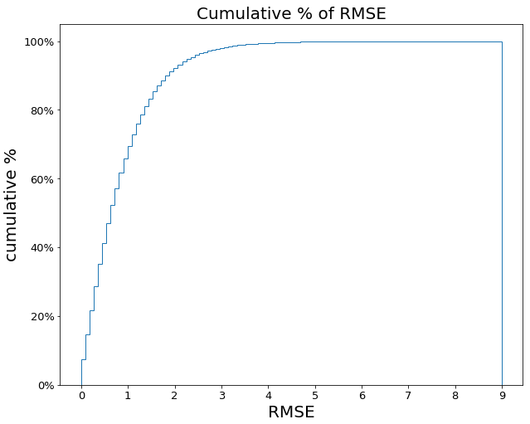
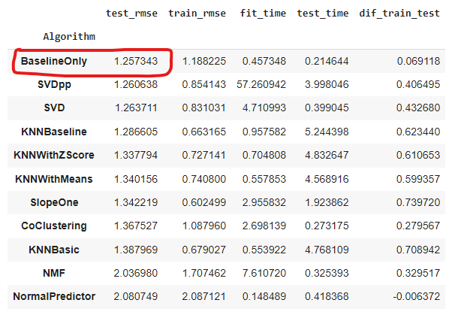
Models Results
Model Results - Random Users Sample
Baseline Only -All User Data

Slide 17
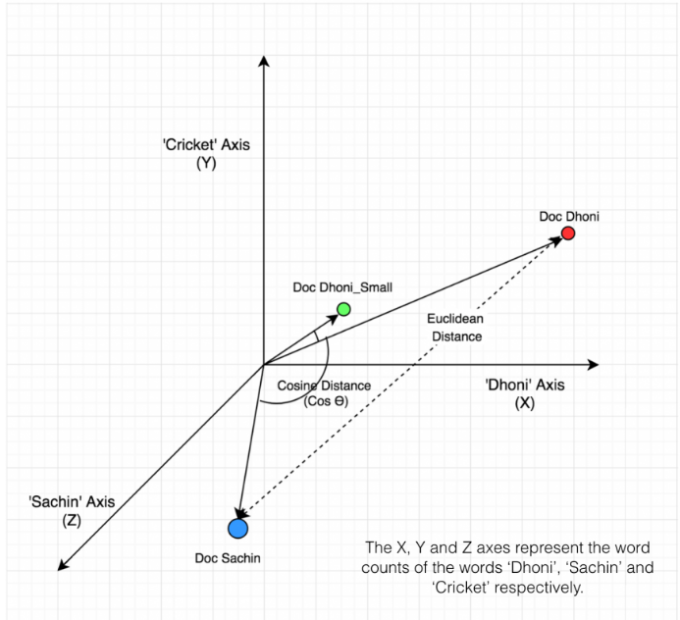
Types of Similarity Matrices
Surprise Matrices
Cosine - Compute the cosine similarity between all pairs of users (or items).
MSD - Compute the Mean Squared Difference similarity between all pairs of users (or items).
Pearson - Compute the Pearson correlation coefficient between all pairs of users (or items).
Pearson_baseline - Compute the (shrunk) Pearson correlation coefficient between all pairs of users (or items) using baselines for centering instead of means.
Not apart of models matrices- compute manually:
Jaccard similarity - the % of common items between two users or the % of common users between two items.
לא צריך זה בדיוק זה חלק מהסבר על למעלה .. אנחנו צריכים לצמצם ולהתרכז בדברים שהם חדשים ואנחנו רוצים להעביר ואם אתה כבר אומר למעלה שאתה משתמש בקוסינוס לא צריך עוד פעם אפשר לשים את זה שם..
Notes:
1 -similarity = distance explain the differences between euclidean distance to cosine distance - picture - differences relative to the blue dot.

Slide 18
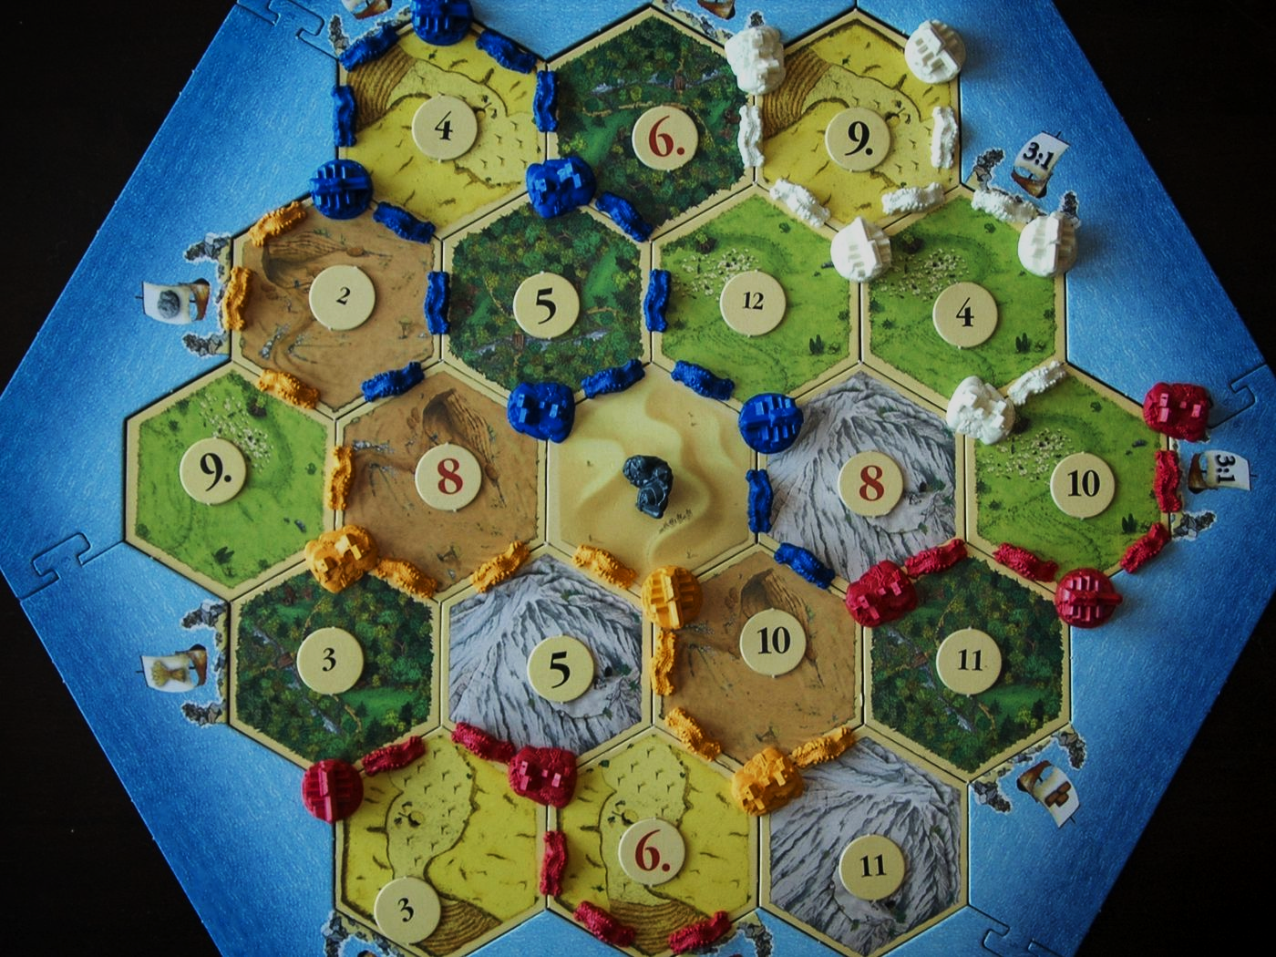
Our Recommendation System Map
Is a new user ?
Yes, a new user
No, not a new user
Suggest
Popular
games
Suggest games according to
a game you loved
(Enter name )
Content filtering -
“because you loved this game we think you would love…”
collaborative filtering -
“people who loved this also loved this…. “

Slide 19
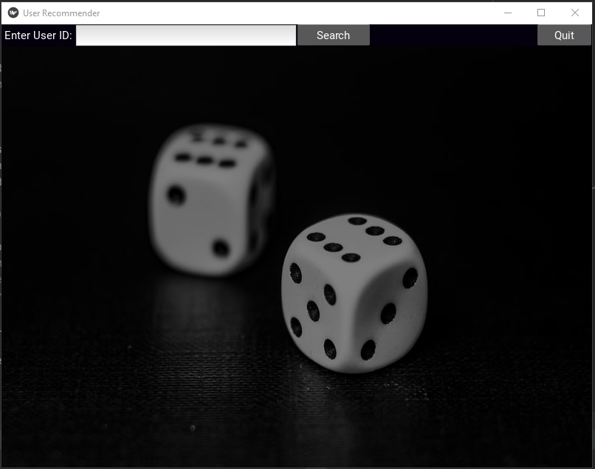
The App
Final product for the costumer . include the the the models and a friendly UI .
bring the right user the right games for him !
user friendly (easy UI)
give user link to buy the games

